Slide 1
LMI for the Careers Leader Part 3 What does the North East labour market look like?
Notes:
Hello and welcome to part 3 of LMI for Careers Leaders. Today we are going to zone in on the North East itself and have a look at the key characteristics of our own labour market.

Slide 2
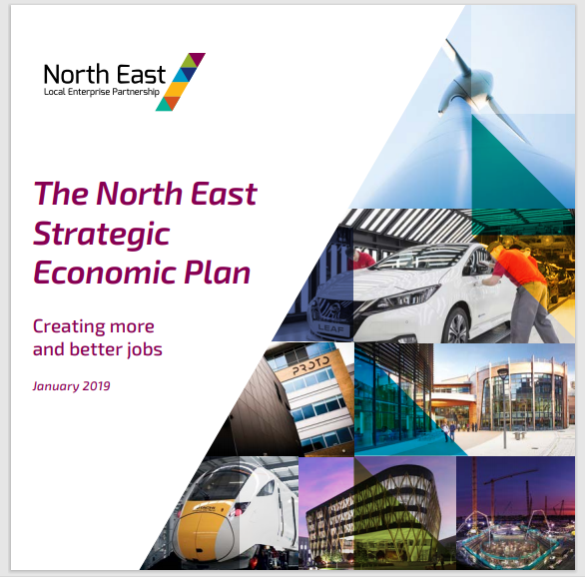
The North East Strategic Economic Plan
“We have one clear and simple ambition – to deliver more and better jobs for the people who live and work in the North East.”
The Strategic Economic Plan 1.51
The North East Strategic Economic Plan
(North East Local Enterprise Partnership. 2019)
Notes:
To begin to understand the labour market in our region it is useful to take a stock take and look at what the aims of the Local Enterprise Partnership are for our region. Many people will be familiar with the Strategic Economic Plan, something that was first published in 2014 by the LEP and its key strategic public and private sector partners. Familiarising yourself with this plan, and its various iterations since then, is the first step in understanding what our region is trying to achieve and how this impacts on our young people in school and college.
“We have one clear and simple ambition – to deliver more and better jobs for the people who live and work in the North East.”
You may want to pause this presentation and have a look at this short video to give you a flavour of the North East and what we our ambitions for the future. It is not simply about tackling unemployment in our region, it is about tackling under-employment, eliminating in-work poverty and improving the quality of all jobs.

Slide 3
The role of the North East Skills Advisory Panel
The SAP focuses on six key objectives in the North East:
Providing young people access to high quality careers guidance
Improving destinations for all young people
Raising skill levels across our workforce
Enabling opportunities for lifelong learning
Improving digital skills for every age group
Supporting the 50+ workforce
Adapted from the Local Skills Report
(North East Local Enterprise Partnership. 2021)
Notes:
A key government initiative in 2019 was the introduction of Skills Advisory Panels which were designed to strengthen the link between employers and skills providers in a region. Skills providers could range from colleges and training providers to universities and private training organisations. As you can see from the priorities of the North East SAP, all six objectives highlighted have a clear relationship with the labour market. All regions in England are required to produce a local skills plan and you can find ours at the end of this video. Do try to find time to read the plan, it relates exclusively to the world of work in our region and can help all educators inspire young people about all the exciting opportunities in our region.

Slide 4
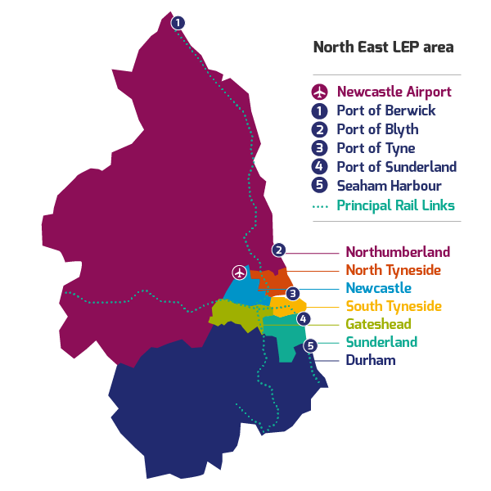
It is important to understand the regional context
Local information can be harder to find but all Local Authorities have their own labour market pages. See slide 9 for links.
Notes:
This is the North East region here. Immediately you can see that a regional labour market will always break down into local labour markets too; we have rural areas, urban areas and coastal. We have built up zones where major international companies are located, and we have large countryside areas where the local economy comprises primarily sole traders and micro-businesses. As many young people will either stay in, or return to, their area of birth it is important that they understand their local economy and what opportunities there are for them.

Slide 5
There is much to be excited about in our region
4 areas of opportunity
4 service sectors
Notes:
So here is the good news…we have eight major sectors of the economy that are putting the North East well and truly on the national and international stage. Four of these sectors are our ‘areas of opportunity’ meaning they are cutting-edge sectors pushing the boundaries of technology and progress. A further four sectors provide the structural support for those areas of opportunity. This does not mean there are not other sectors for people to work in, and it is important to remember that there is always a replacement-demand in every economic sector, it just means that these are the key sectors which are pushing our economy forward.

Slide 6
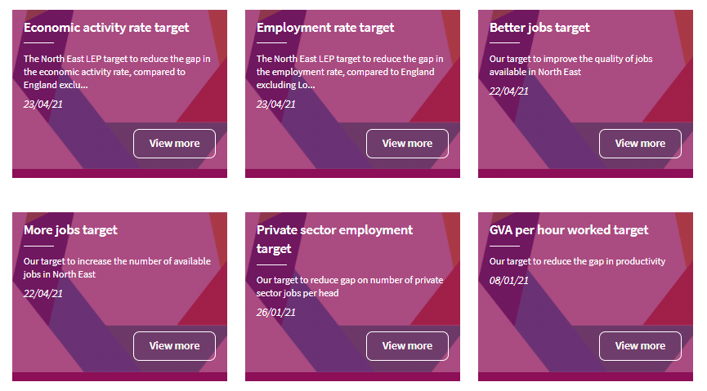
For statistical data you can use the datahub
Notes:
For the facts and figures about these sectors have a look at the North East LEP’s Evidence Hub. Here you will find not only the statistics you may need to deliver effective LMI but also the commentary. The Evidence Hub is updated whenever key national datasets are released, and you can therefore be assured that the site is comprehensive and up to date. The LEP is also producing sector toolkits which can be found on the North East Ambition website; these will link our region’s areas of opportunity with key areas of learning in the core subjects of English, maths and science. Just remember what we said in part 1, the facts and figures need to be part of something, part of a strategy and part of something that really makes an impact on your students.

Slide 7
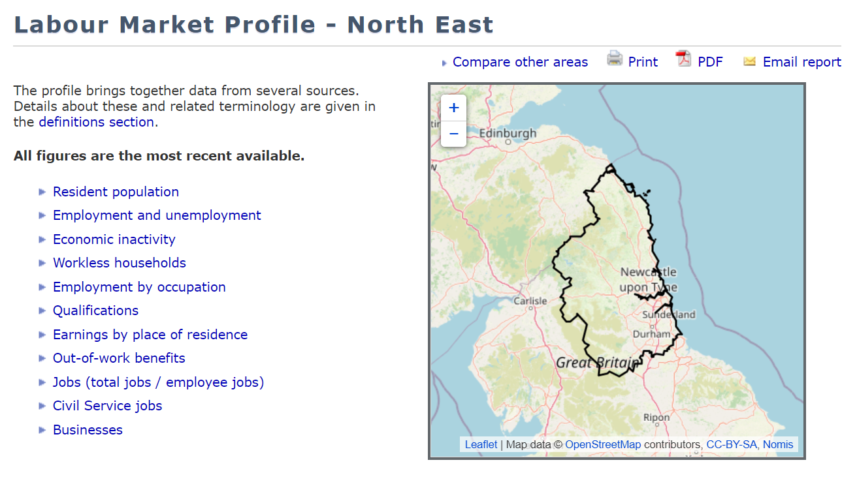
You can also use regional data from the ONS
Search on Local Authority areas for a breakdown of the data at local level
Notes:
Further statistical information can be found from the ONS, the Office for National Statistics. The ONS is the foremost collector of labour market statistics in our country and, as you might expect, they have been keeping a close watch on all things labour market-related during the Covid crisis. If you are looking for a quick set of statistics from either a region or a local authority try searching on the ONS NOMIS site. You can see from the list of items on the slide the range of figures that are available on these searches.

Slide 8
Within these sectors there are occupations
Just remember that the sector name itself does not tell you much about the occupations – or jobs – available within it. For example:
Sector | Job role | Occupational group | Place of work
Health and Social Work | IT Network manager | Professional | Hospital
Education | Gardener | Skilled Trades | School
Wholesale and Retail | Interior designer | Associate Professional | Department store
Manufacturing | Kitchen assistant | Elementary (service) | Factory canteen
Sector information is produced by the ONS – see ‘Summary of Structure for UK SIC’
Occupational information is also produced by the ONS – see ‘SOC 2020 Volume 2: the coding index’
Notes:
However, young people are interested in the ‘jobs’ they can do. A sector may appear interesting but what would you actually be doing in the role on a daily basis? Another word for job is occupation and sectors are full of different occupations at all levels, from elementary occupations requiring no qualifications to professional occupations requiring first degrees and postgraduate qualifications. This slide shows the differences between the sector a person might work in, the occupation they might have and the workplace in which they may find themselves.

Slide 9
If you’re eager to learn more…
Nomis - Official Labour Market Statistics
North East : Business News | Bdaily
Business Live - register for daily bulletin
There are 7 Local Authorities within the North East LEP area. Though all LAs display labour market information in different ways there should always be something useful to find when researching opportunities in your own area.
Northumberland, North Tyneside, Newcastle
Gateshead, South Tyneside, Sunderland, Durham
We Go Again!
The North East bounces back…
2.16
Notes:
As ever, have a look at the following links if you would like to find out more. These sites will flesh out what we have talked about in this video and give you a few ideas about how you can develop content and delivery resources for your students.

Slide 10
In Part 4 we will ask the question how can LMI be used in the curriculum?
info@nelep.co.uk
Notes:
In the next video we will look at how others in your school and college can be involved in the delivery of LMI. This is not a job just for the Careers Leader, this is a job for everyone, and the next video will give you some tips on how you can share the responsibility of preparing your students for the labour market.

