Slide 1

Our Region, Your Future
The world of work in the North East
KS5 Lesson
In association with VotesforSchools and The WOW Show
©VotesforSchools The WOW Show 2022

Slide 2






Learning objectives for today
Actively seeking out help, support and feedback.
Actively seeking out information on the labour market and education system to support your career.
Actively planning, prioritising and setting targets for your future.
Considering entrepreneurialism and self-employment as a career pathway.
Planning for the kind of balance of work and life that you want.
Exploring and responding to local and national labour market trends.
©VotesforSchools The WOW Show 2022
Notes:
References
https://www.thecdi.net/New-Career-Development-Framework

Slide 3
Keywords
Labour Market Information (LMI): Information about the jobs and careers available in a geographical area.
Sector: The areas into which the economic activity of a country is divided.
Employability: Having the skills and abilities needed to have a job or career.
Career: The job or series of jobs that you do during your working life.
Labour market: The supply of people in a particular country or area who are able and willing to work.
Entrepreneur: Someone who starts their own business, especially when this involves seeing a new opportunity.
©VotesforSchools The WOW Show 2022
Notes:
References
https://dictionary.cambridge.org/dictionary/english/sector
https://dictionary.cambridge.org/dictionary/english/employability
https://dictionary.cambridge.org/dictionary/english/career
https://dictionary.cambridge.org/dictionary/english/labour-market
https://dictionary.cambridge.org/dictionary/english/work-life-balance

Slide 4
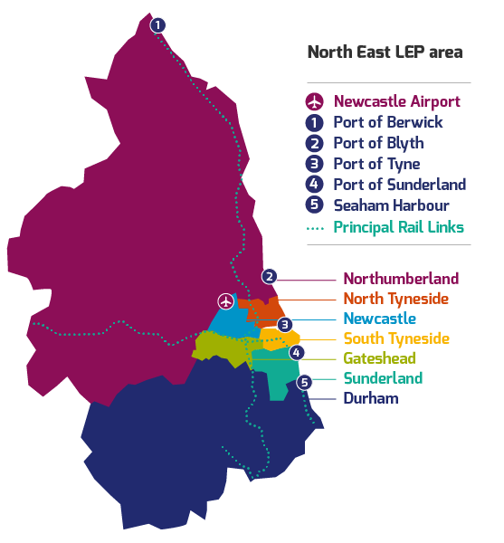

1
What is Labour Market Information?
Define: Labour Market Information (LMI)
This tells you about the current work and job opportunities in your area.
LMI is important for social mobility. It allows young people to be more equipped to understand what is on offer in their region and how to get there by making informed decisions about their future career choices.
Class discussion (2-3 mins)
How do you think Labour Market Information could help you find a job in your area?
It helps decode the world of work by breaking it down into digestible chunks.
LMI highlights the fantastic career opportunities available and what existing opportunities and growth areas there are in your region.
©VotesforSchools The WOW Show 2022
Notes:
Images
North East LEP
References
http://www.lmiforall.org.uk/explore_lmi/
https://www.lmiforall.org.uk/explore_lmi/learning-units/what-is-lmi/ - There is a YouTube video explaining LMI if needed on this page.

Slide 5


1
What is Labour Market Information?
LMI can help you understand what jobs are available near to you and how many jobs there are in different sectors now and projected in the future.
Define: Sector
An area of work and production that makes money for an area or country.
Individual activity (2-3 mins)
Write down three careers that interest you for the future.
LMI could help you see where job opportunities are and how much certain roles pay. This can help you think about what you want.
LMI is updated regularly, so you can see how job opportunities change and some sectors grow.
©VotesforSchools The WOW Show 2022
Notes:
Images
North East LEP
References
http://www.lmiforall.org.uk/explore_lmi/
https://www.lmiforall.org.uk/explore_lmi/learning-units/what-is-lmi/ - There is a YouTube video explaining LMI if needed on this page.

Slide 6
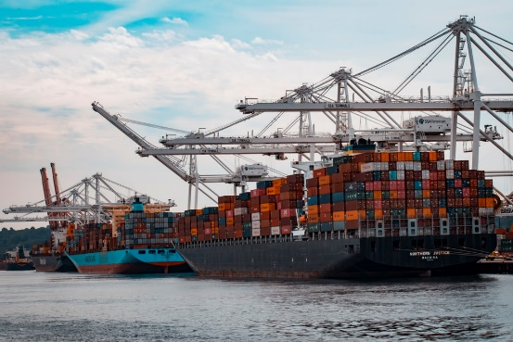






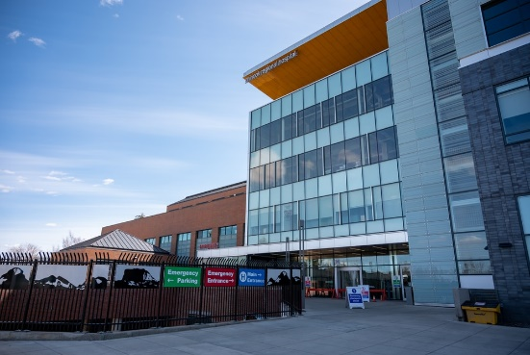
2
The North East Labour Market
Pair discussion (2-3 mins)
Talk to your partner about what opportunities you know of in your local area – click for some picture hints. Then, head to the next slide for more information on the sectors that have roles on offer in the North East.
Challenge:
Do you know what kind of work is involved in each of these sectors?
©VotesforSchools The WOW Show 2022
Notes:
Please Note: The North East Local Enterprise Partnership works with partners to develop a more competitive economy for the North East, Helping to create more and better jobs for everyone.
Images
Unsplash
References
https://www.northeastambition.co.uk/toolkits/labour-market-insights-toolkit
https://www.northeastlep.co.uk/key-sectors/
https://evidencehub.northeastlep.co.uk/report/gva-industry
https://dictionary.cambridge.org/dictionary/english/manufacturing
https://dictionary.cambridge.org/dictionary/english/administration
https://dictionary.cambridge.org/dictionary/english/retail
https://dictionary.cambridge.org/dictionary/english/social-care

Slide 7
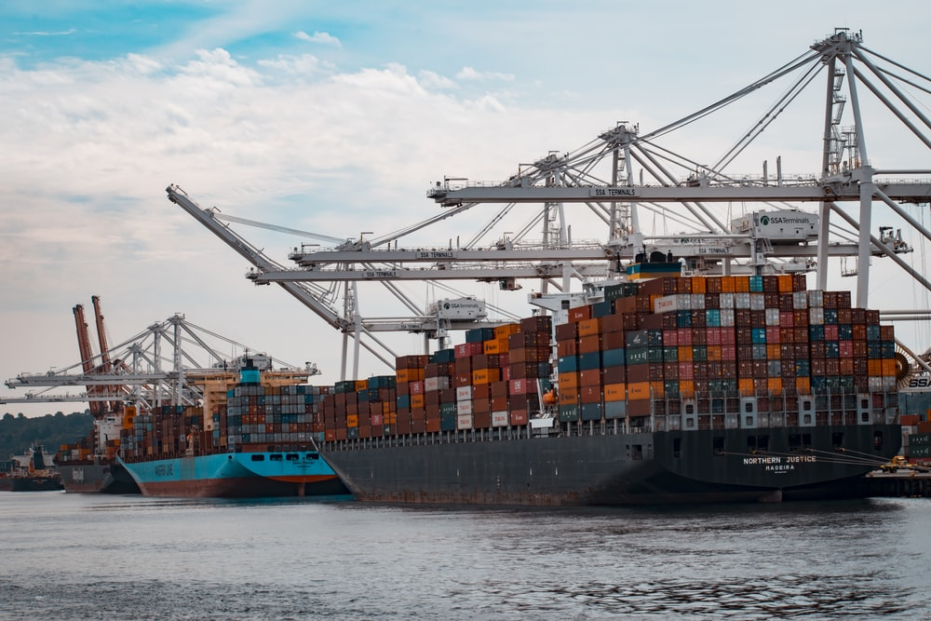



2
The North East Labour Market
Transport & Logistics:
Transport of people and movement of goods.
Advanced Manufacturing:
This includes making parts for cars, trains, electronics and subsea engineering.
Construction:
Building and work across all parts of our built environment.
Health & Life Sciences:
Research and development into health and care, including social care.
©VotesforSchools The WOW Show 2022
Notes:
Please Note: The North East Local Enterprise Partnership works with partners to develop a more competitive economy for the North East, Helping to create more and better jobs for everyone.
Images
Unsplash
References
https://www.northeastambition.co.uk/toolkits/labour-market-insights-toolkit
https://www.northeastlep.co.uk/key-sectors/
https://evidencehub.northeastlep.co.uk/report/gva-industry
https://dictionary.cambridge.org/dictionary/english/manufacturing
https://dictionary.cambridge.org/dictionary/english/administration
https://dictionary.cambridge.org/dictionary/english/retail
https://dictionary.cambridge.org/dictionary/english/social-care

Slide 8




2
The North East Labour Market
Digital:
Work involving Information Technology (IT) and digital data.
Education:
There are over 1,150 schools in the North East and five universities.
Financial & Business Services:
This includes financial and legal services.
Energy:
Research and development in producing energy.
©VotesforSchools The WOW Show 2022
Notes:
Please Note: The North East Local Enterprise Partnership works with partners to develop a more competitive economy for the North East, Helping to create more and better jobs for everyone.
There are four Universities in the North East LEP and one in Tees Valley
There are nine Further Education colleges and two sixth forms
There are over 240 secondaries including SEND, PRU and Alternative Provision
There are over seven hundred primaries
Images
Unsplash
References
https://www.northeastambition.co.uk/toolkits/labour-market-insights-toolkit
https://www.northeastlep.co.uk/key-sectors/
https://evidencehub.northeastlep.co.uk/report/gva-industry
https://dictionary.cambridge.org/dictionary/english/manufacturing
https://dictionary.cambridge.org/dictionary/english/administration
https://dictionary.cambridge.org/dictionary/english/retail
https://dictionary.cambridge.org/dictionary/english/social-care

Slide 9
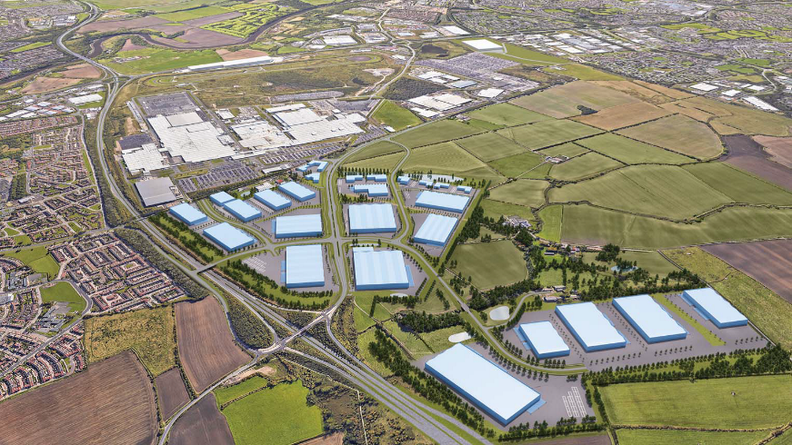
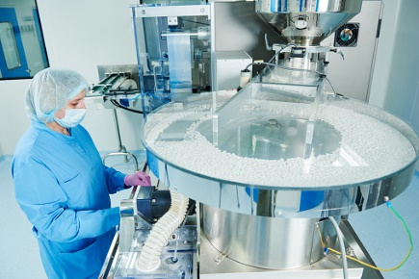
3
Your North East opportunities in Advanced Manufacturing
The North East has a fantastic reputation in Advanced Manufacturing, with lots of great opportunities!
0:00-2:16
Our region manufactures automotive products including passenger cars, trains and heavy off-road vehicles and a range of parts and components.
Class activity (4 mins)
Click the image to watch the video about the facts and figures in advanced manufacturing in the North East. Do any of the careers featured interested you?
The North East medicines cluster produces 33% of the UK’s GDP in pharmaceutical manufacture and packaging.
Define: GDP
Gross Domestic Product is a measure of the health and size of a country’s economy.
©VotesforSchools The WOW Show 2022
Notes:
YouTube Video Link: https://youtu.be/cg1cHr2lXl8
SafeShare Video Link: https://safeshare.tv/x/ss61f7c4eb81103
Images
Via video
References
https://www.northeastlep.co.uk/key-sectors/advanced-manufacturing/
https://www.northeastlep.co.uk/projects-and-funding/projects/international-advanced-manufacturing-park-iamp/
https://evidencehub.northeastlep.co.uk/report/advanced-manufacturing
https://www.bankofengland.co.uk/knowledgebank/what-is-gdp
https://www.northeastlep.co.uk/wp-content/uploads/2015/10/Lifescience-Brochure-23-10-15-amended.pdf

Slide 10

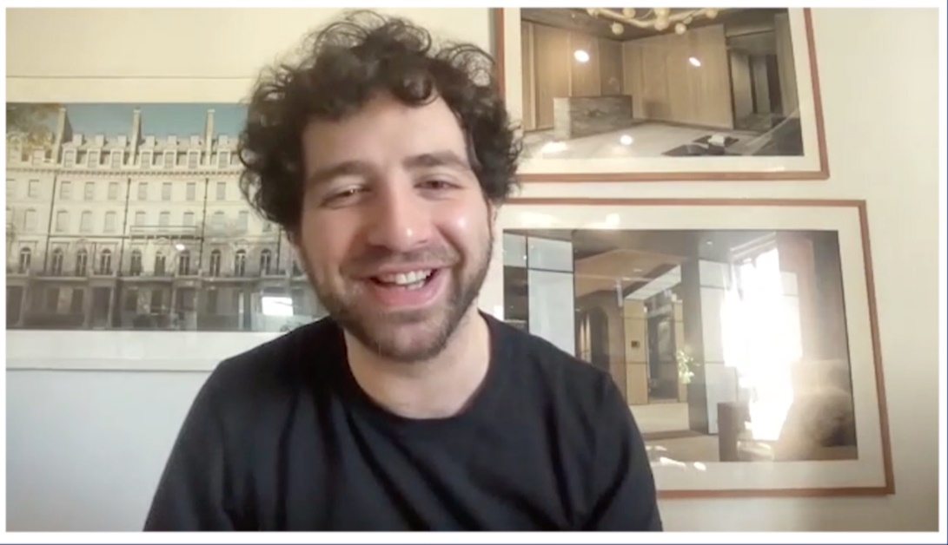
4
Could you be an entrepreneur?
Pair activity (4-5 mins)
Watch the video of Jonathan Grubin from SoPost talking about his businesses. Discuss the following with your partner: Do you have an idea for a business? Have you ever thought about running your own? What would it be?
Define: Entrepreneur:
Someone who starts their own business, or sees a new opportunity for a career.
0:00-5:54
It’s possible that business runs in your family. Or, are you a future entrepreneur with your own original idea? Either way, there are lots of opportunities to make your ideas a reality.
Did you know there were 5.9 million small businesses across the UK at the start of 2020? There are definitely potential advantages to working for smaller businesses or yourself. Head to the next slide to check them out!
©VotesforSchools The WOW Show 2022
Notes:
YouTube Video Link:
Safeshare TV Video Link: https://safeshare.tv/x/ss6217eee613865
Images
Unsplash

Slide 11







4
Could you be an entrepreneur?
Flexible working hours
Making your own decisions
Higher earnings
Personal achievement and growth
Being your own boss
Challenge:
What could be the possible disadvantages?
©VotesforSchools The WOW Show 2022
Notes:
Images
Unsplash

Slide 12





5
Helping you along
No matter your career aspirations, it’s always useful to spend some time considering what’s coming next.
Pair activity (4-5 mins)
Have you tried any of the things below when it comes to exploring jobs and further education? Share with a partner where you look and how you keep a record of feedback or good websites and sources of information.
Define: Feedback
Information that is given to say if something is successful in its aims or not.
Maybe you can set aside a little bit of time each week to look at opportunities on the internet with friends or family members?
There are lots of great websites that can help with writing job applications and making sure you fit the person specification and job description.
Or, you could give your CV or personal statement to others to get some feedback on how well it represents you.
©VotesforSchools The WOW Show 2022
Notes:
Teacher notes:
The mix and icould have excellent information for students
Images
Unsplash
References
https://dictionary.cambridge.org/dictionary/english/feedback
https://icould.com/explore/categories/career-paths/getting-a-job/getting-a-job
https://www.themix.org.uk/work-and-study
https://icould.com/

Slide 13

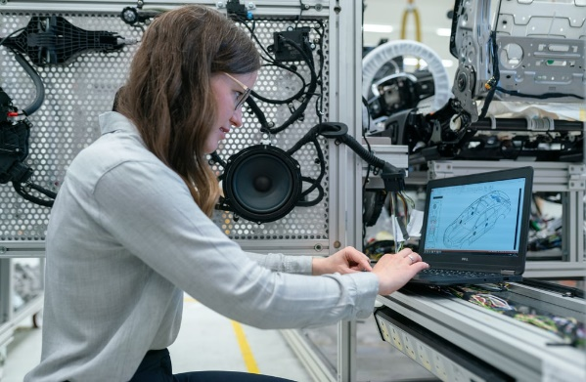
6
Future choices: Apprenticeships
One future pathway that you may not have explored is an apprenticeship.
Pair activity (1 min)
You have 60 seconds to discuss what you know about apprenticeships with your partner!
Apprenticeships allow you to combine work and study by mixing on-the-job training with classroom learning. You'll be employed to do a real job while studying for a formal qualification, usually for one day a week either at a college, a training centre or in the workplace.
There are over 600 different apprenticeships available from accountancy to zoo keeping.
Challenge:
Amazing Apprenticeships have lots of information about apprenticeships, as well as a huge selection of vacancies from national employers. Why not check them out?
Pair activity (2 mins)
Based on the information above, discuss the advantages and disadvantages of an apprenticeship. Could it be an option for you?
©VotesforSchools The WOW Show 2022
Notes:
Images
Unsplash
References
https://findapprenticeshiptraining.apprenticeships.education.gov.uk/#
https://www.northeastgrowthhub.co.uk/scheme/business-support/apprenticeship-training/
https://amazingapprenticeships.com/apprenticeships/

Slide 14
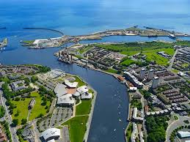
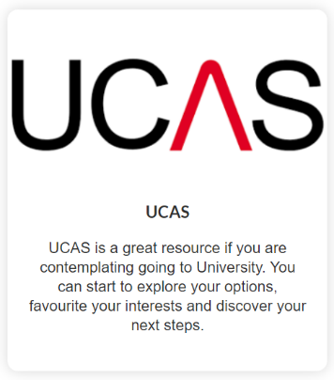
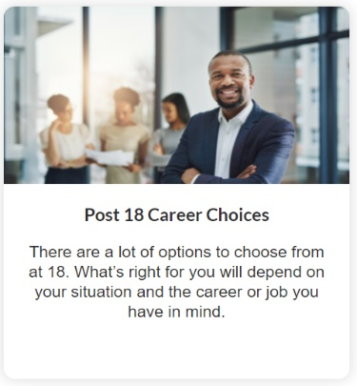
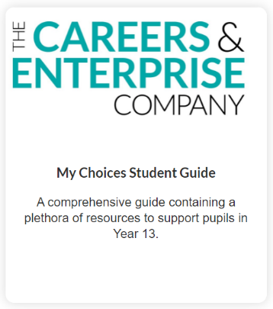
6
Future choices: Further and Higher Education
Another possible future pathway is further education. This comes in many different forms, including Traineeships, Vocational Qualifications and Internships.
Individual activity (2-3 mins)
Consider what your ideal career would be. Does it require further training or qualifications? Where could you get these things from?
There are lots of resources and websites that will help you find your future no matter which direction you are heading in. Here are just a few.
Define: Further Education:
Education below the level of a university degree for people who have left school.
Whilst making decisions about the future can seem scary, but with North East Ambitions providing information and guidance you can feel confident in your choices.
Define: Higher Education:
Education at a college or university where subjects are studied at an advanced level.
©VotesforSchools The WOW Show 2022
Notes:
Teacher notes:
Further Education – education below the level of a university degree for people who have left school - https://dictionary.cambridge.org/dictionary/english/further-education
Higher Education – education at a college or university where subjects are studied at an advanced level - https://dictionary.cambridge.org/dictionary/english/higher-education
LINK: https://successatschool.org/advicedetails/860/what-is-further-higher-education
Images
Unsplash
References
https://www.goodschoolsguide.co.uk/careers/further-education/what-is-further-education#:~:text=Further%20Education%20(FE)%20refers%20to,FE%20until%20they%20are%2018.
https://www.educationpartnershipne.ac.uk/
https://nationalcareers.service.gov.uk/careers-advice/career-choices-at-16
https://resources.careersandenterprise.co.uk/resources/my-choices-guide-students

Slide 15



7
Planning your future: Priorities & target-setting
Individual reflection (3-5 mins)
Now you’ve listened to everything in this lesson, do you have a better idea of where you want to go and what you would like to do? If so, have you thought of what you need to prioritise to get there? What targets do you need to set yourself to reach your goals? Use the ideas below to help you.
Map out the small steps you need to take to keep you focused and on track to your best future.
Discuss what you want to do and how you will get there with friends and family.
Set yourself SMART targets to get there. SMART targets are Specific, Measurable, Accepted, Realistic and Time-bound.
©VotesforSchools The WOW Show 2022
https://saeshare.tv/x/9xCn-Kwy97U
Notes:
Reference:
SMART - https://www.bbc.co.uk/bitesize/guides/zwr34j6/revision/3
Specific – state exactly what will need to be done
Measurable – clear what success will look like
Accepted – decided on by all participants in the process
Realistic – know it is practical – steps can be taken to do it
Time bound – state when it will be achieved
Images
Unsplash

Slide 16



8
Can you balance life & work?
Pair discussion (4-5 mins)
Although the practicalities of working life (and finding work!) are important, another important aspect of your career will be balancing your time at work with other parts of your life. Talk to your partner about why balance is important for your physical and mental health and what we can do to strike this balance. Click for some ideas.
There is a lot of research that says spending time in nature is good for our mental health.
If you can’t spend time in nature, can you spend time with friends and family?
Could you spend time being creative with words, art, photography or another medium?
Individual reflection (1-2 mins)
How is your mental health? Do you know where to get help and support?
©VotesforSchools The WOW Show 2022
Notes:
Images
Unsplash
References
https://www.mind.org.uk/

Slide 17



9
Recognising learning pathways
The internet has a whole host of information sources. For instance, The National Careers Service, Start and icould all have great support and advice. Click on the logos to visit their sites.
The National Careers Service provides careers information, advice and guidance. They can help you to make decisions on learning, training and work at all stages in your career.
Start will help you to find out which subjects and qualifications will help to prepare you for your future? Also, which pathway is right for you?
icould is a great place to get tips on GCSE options, apprenticeships, university, finding work (and much more!).
©VotesforSchools The WOW Show 2022
Notes:
Images & References
https://icould.com/
https://careers.startprofile.com/page/home-page
https://nationalcareers.service.gov.uk/

Slide 18
Thank you!
©VotesforSchools The WOW Show 2022

