Slide 1

Our Region, Your Future
The world of work in the North East
Y7 Lesson
In association with VotesforSchools and The WOW Show
©VotesforSchools The WOW Show 2022

Slide 2






Learning objectives for today
Being aware that learning, skills and qualifications are important for careers.
Being aware of the range of possible jobs.
Being aware that career describes your journey through life, learning and work.
Developing the ability to communicate your needs and wants.
Being aware of rights and responsibilities in the workplace and in society.
Being aware that there are trends in local and national labour markets.
©VotesforSchools The WOW Show 2022
Notes:
Images & References
https://www.thecdi.net/New-Career-Development-Framework

Slide 3
Keywords
Labour Market Information (LMI): Information about the jobs and careers available in a geographical area.
Sector: The areas into which the economic activity of a country is divided.
Employability: Having the skills and abilities needed to have a job or career.
Career: The job or series of jobs that you do during your working life.
Labour market: The supply of people in a particular country or area who are able and willing to work.
©VotesforSchools The WOW Show 2022
Notes:
References
https://dictionary.cambridge.org/dictionary/english/sector
https://dictionary.cambridge.org/dictionary/english/employability
https://dictionary.cambridge.org/dictionary/english/career
https://dictionary.cambridge.org/dictionary/english/labour-market

Slide 4


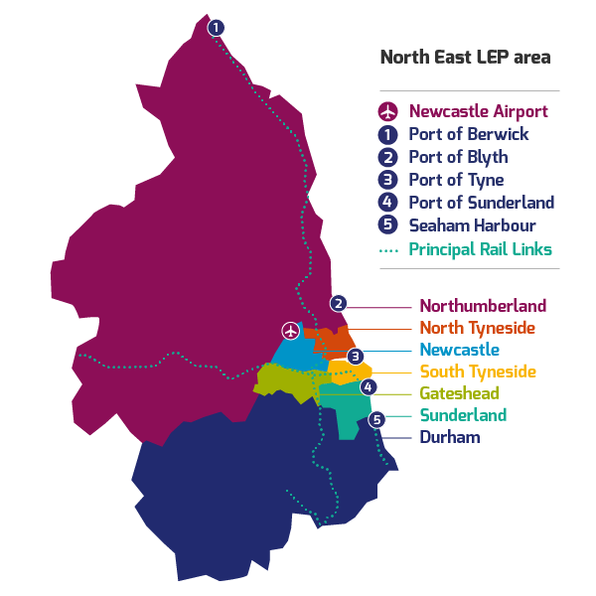
1
What is Labour Market Information?
Define: Labour Market Information (LMI)
This tells you about the current work and job opportunities in your area.
LMI is important for the future, it allows young people to understand what is on offer in their area and how to get there by making good decisions about their future career choices.
Class discussion (2-3 mins)
How do you think Labour Market Information could help you find a job in your area?
It helps us understand the world of work by breaking it down into smaller parts.
LMI highlights the fantastic career opportunities available and what existing opportunities and growth areas there are near you.
©VotesforSchools The WOW Show 2022
Notes:
References:
http://www.lmiforall.org.uk/explore_lmi/
https://www.lmiforall.org.uk/explore_lmi/learning-units/what-is-lmi/ - There is a YouTube video explaining LMI if needed on this page.

Slide 5


1
What is Labour Market Information?
LMI can help you understand which jobs are available near to you and how many jobs there are in all the different sectors.
Define: Sector
An area of work and production that makes money for an area or country.
Individual activity (2-3 mins)
Write down three careers that interest you for the future.
LMI could help you see where job opportunities are and how much certain roles pay.
LMI is updated regularly, so you can see how job opportunities change and some sectors grow.
©VotesforSchools The WOW Show 2022
Notes:
References
http://www.lmiforall.org.uk/explore_lmi/
https://www.lmiforall.org.uk/explore_lmi/learning-units/what-is-lmi/ - There is a YouTube video explaining LMI if needed on this page.
Images:
1) NELEP

Slide 6







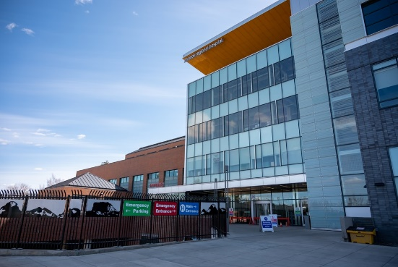
2
The North East Labour Market
Pair discussion (2-3 mins)
Talk to your partner about what opportunities you know of in your local area – click for some picture hints. Then, head to the next slide for more information on the sectors that have roles on offer in the North East.
Challenge:
Do you know what kind of work is involved in each of these sectors?
©VotesforSchools The WOW Show 2022
Notes:
Please Note: The North East Local Enterprise Partnership works with partners to develop a more competitive economy for the North East, Helping to create more and better jobs for everyone.
Images
Unsplash
References
https://www.northeastambition.co.uk/toolkits/labour-market-insights-toolkit
https://www.northeastlep.co.uk/key-sectors/
https://evidencehub.northeastlep.co.uk/report/gva-industry
https://dictionary.cambridge.org/dictionary/english/manufacturing
https://dictionary.cambridge.org/dictionary/english/administration
https://dictionary.cambridge.org/dictionary/english/retail
https://dictionary.cambridge.org/dictionary/english/social-care

Slide 7




2
The North East Labour Market
Transport & Logistics:
Transport of people and movement of goods (things we buy).
Advanced Manufacturing:
This includes making parts for cars, trains, electronics and subsea engineering.
Construction:
Building and work across all parts of our built environment.
Health & Social Care:
Research and development into health and care (looking after people).
©VotesforSchools The WOW Show 2022
Notes:
Please Note: The North East Local Enterprise Partnership works with partners to develop a more competitive economy for the North East, Helping to create more and better jobs for everyone.
Images
Unsplash
References
https://www.northeastambition.co.uk/toolkits/labour-market-insights-toolkit
https://www.northeastlep.co.uk/key-sectors/
https://evidencehub.northeastlep.co.uk/report/gva-industry
https://dictionary.cambridge.org/dictionary/english/manufacturing
https://dictionary.cambridge.org/dictionary/english/administration
https://dictionary.cambridge.org/dictionary/english/retail
https://dictionary.cambridge.org/dictionary/english/social-care

Slide 8




2
The North East Labour Market
Digital:
Work involving Information Technology (IT) and digital data.
Education:
There are over 1,150 schools in the North East and five universities.
Financial & Business Services:
This includes financial and legal services.
Energy:
Research and development in producing energy.
©VotesforSchools The WOW Show 2022
Notes:
Please Note: The North East Local Enterprise Partnership works with partners to develop a more competitive economy for the North East, Helping to create more and better jobs for everyone.
There are four Universities in the North East LEP and one in Tees Valley
There are nine Further Education colleges and two sixth forms
There are over 240 secondaries including SEND, PRU and Alternative Provision
There are over seven hundred primaries
Images
Unsplash
References
https://www.northeastambition.co.uk/toolkits/labour-market-insights-toolkit
https://www.northeastlep.co.uk/key-sectors/
https://evidencehub.northeastlep.co.uk/report/gva-industry
https://dictionary.cambridge.org/dictionary/english/manufacturing
https://dictionary.cambridge.org/dictionary/english/administration
https://dictionary.cambridge.org/dictionary/english/retail
https://dictionary.cambridge.org/dictionary/english/social-care

Slide 9
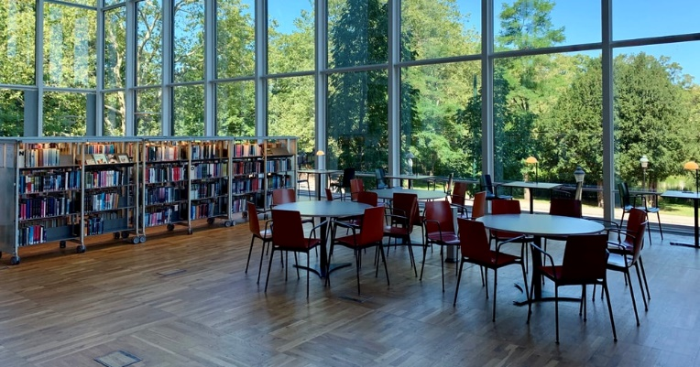




2
The North East Labour Market
Mind the gaps (3-5 mins)
Now you’ve seen the range of active sectors in the North East, it’s time to see some of the numbers behind them. On your own or in a pair, choose the right answer to fill the gap in each statement on the next few slides – you can use the images to help you. Then, click to see if you’re right!
©VotesforSchools The WOW Show 2022
Notes:
Images
Unsplash
References
https://www.northeastlep.co.uk/key-sectors/digital/
https://www.northeastlep.co.uk/key-sectors/advanced-manufacturing/
https://www.northeastlep.co.uk/key-sectors/energy/

Slide 10

2
The North East Labour Market
On your own or in a pair, choose the right answer to fill the gap!
A
26%
B
52%
_______% of all electric cars made in the UK are produced in the North East.
C
78%
©VotesforSchools The WOW Show 2022
Notes:
Images
Unsplash
References
https://www.northeastlep.co.uk/key-sectors/digital/
https://www.northeastlep.co.uk/key-sectors/advanced-manufacturing/
https://www.northeastlep.co.uk/key-sectors/energy/

Slide 11

2
The North East Labour Market
On your own or in a pair, choose the right answer to fill the gap!
A
10,000
B
29,000
C
There are _________ people employed in the North East in IT and digital industries
45,000
©VotesforSchools The WOW Show 2022
Notes:
Images
Unsplash
References
https://www.northeastlep.co.uk/key-sectors/digital/
https://www.northeastlep.co.uk/key-sectors/advanced-manufacturing/
https://www.northeastlep.co.uk/key-sectors/energy/

Slide 12
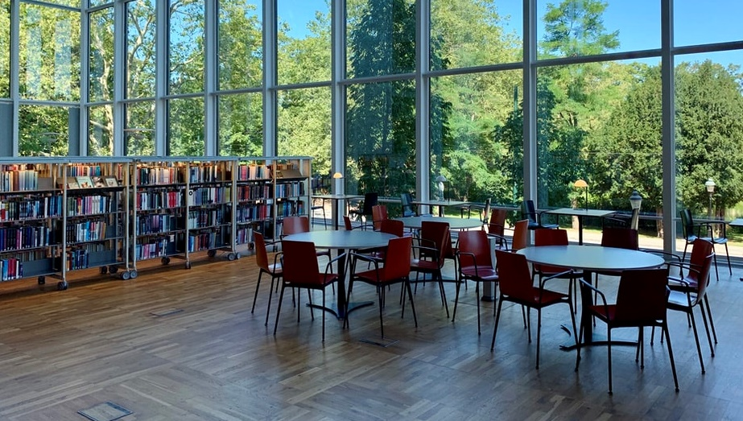
2
The North East Labour Market
On your own or in a pair, choose the right answer to fill the gap!
A
81,000
B
110,000
___________ students study in the region’s 5 universities.
C
210,000
©VotesforSchools The WOW Show 2022
Notes:
Images
Unsplash
References
https://www.northeastlep.co.uk/key-sectors/digital/
https://www.northeastlep.co.uk/key-sectors/advanced-manufacturing/
https://www.northeastlep.co.uk/key-sectors/energy/

Slide 13

2
The North East Labour Market
On your own or in a pair, choose the right answer to fill the gap!
A
7,000
B
700
C
There are currently __________ people employed in life sciences in the North East.
70
©VotesforSchools The WOW Show 2022
Notes:
Images
Unsplash
References
https://www.northeastlep.co.uk/key-sectors/digital/
https://www.northeastlep.co.uk/key-sectors/advanced-manufacturing/
https://www.northeastlep.co.uk/key-sectors/energy/

Slide 14

2
The North East Labour Market
On your own or in a pair, choose the right answer to fill the gap!
A
Electric cars
B
Offshore wind
The North East is a global leader in __________.
C
Eco-farming
©VotesforSchools The WOW Show 2022
Notes:
Images
Unsplash
References
https://www.northeastlep.co.uk/key-sectors/digital/
https://www.northeastlep.co.uk/key-sectors/advanced-manufacturing/
https://www.northeastlep.co.uk/key-sectors/energy/

Slide 15
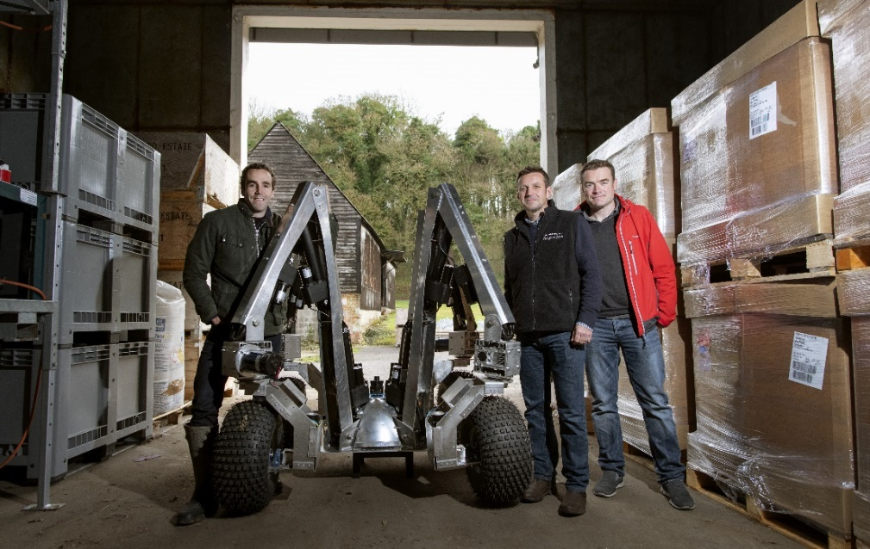

3
Your North East opportunities in Digital Technology
If you are interested in robots and computer programming, then you could be the future of agriculture!
0:00-2:16
Class activity (3-4 mins)
Click the image to watch the video and discuss any of the careers featured that you would be interested in.
Small Robot Company (SRC), which focuses on sustainable farming, today announced that its initial fleet of 10 robots will be manufactured by Tharsus, a Blyth-based advanced machine and robots designer and manufacturer.
©VotesforSchools The WOW Show 2022
https://safeshare.tv/x/McUhua_gnpw
Notes:
YouTube Video Link: https://www.youtube.com/watch?v=McUhua_gnpw&t=147s ( - )
SafeShare Video Link: https://safeshare.tv/x/McUhua_gnpw
Images
https://drive.google.com/file/d/1aq4LJ7oXkW64Wmnoymfy84fY2TmqR3FR/view
References
https://bdaily.co.uk/articles/2020/02/07/fleet-of-farming-robots-to-produced-in-Northumberland
https://www.smallrobotcompany.com/press-releases/2020/2/7/small-robot-company-announces-robot-fleet-manufacture-with-tharsus

Slide 16
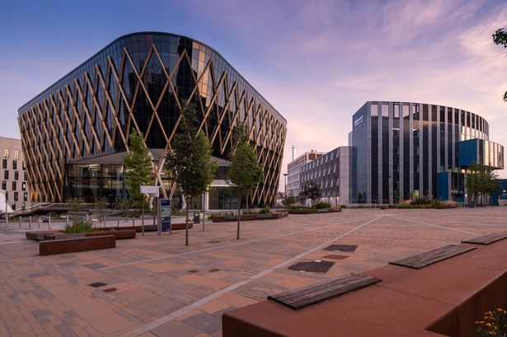

3
Your North East opportunities in Digital Technology
There are thousands of great opportunities across the North East, it has one of the fastest growing digital and tech clusters in the United Kingdom.
0:00-2:17
Class activity (2-3 mins)
Click the image to watch the video and discuss any of the careers featured that you would be interested in.
The North East currently has 32,000 creative employees in immersive technology, software development, data management, games development and so much more.
©VotesforSchools The WOW Show 2022
https://safeshare.tv/x/McUhua_gnpw
Notes:
YouTube Video Link: https://www.youtube.com/watch?v=BaJSciOb2nI&list=PLGVCpm23HHF_z_m8W1dRkwU1BwV2uA5fB
SafeShare Video Link: https://safeshare.tv/x/BaJSciOb2nI
Images
1) https://www.google.com/url?sa=i&url=https%3A%2F%2Fwww.business-live.co.uk%2Feconomic-development%2Fhundreds-north-east-smes-benefit-19072739&psig=AOvVaw3K0QHCT5W5icgzEsMZVPgW&ust=1643291659695000&source=images&cd=vfe&ved=0CAwQjhxqFwoTCJC05tLIz_UCFQAAAAAdAAAAABAD
References

Slide 17
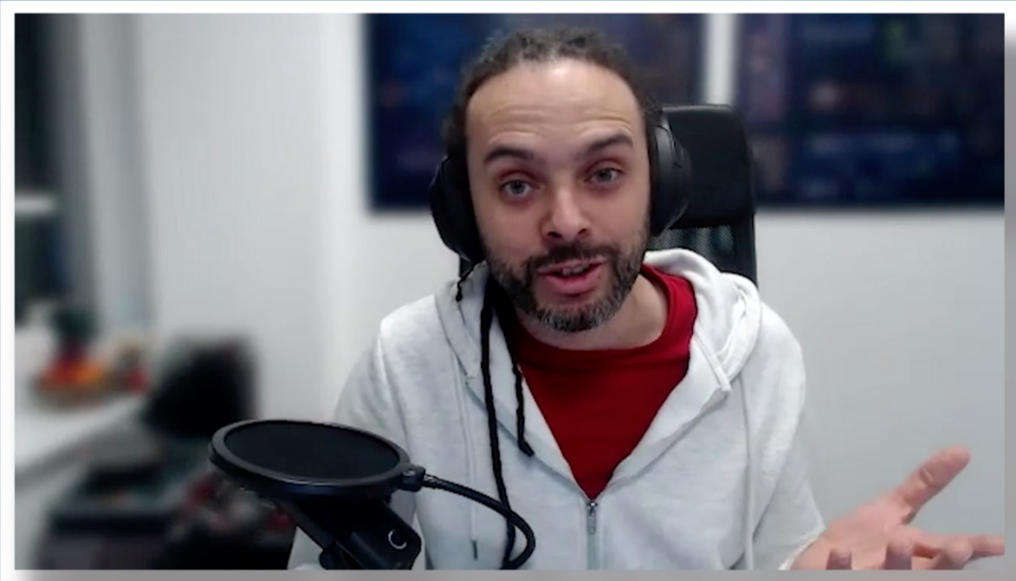

3
Your North East opportunities in Digital Technology
The Digital Industries account for £1.4 billion in the North East economy.
0:00-2:46
Class activity (3-4 mins)
Click the image to watch the video of Dan Baird at Infinity27. Listen carefully to the soft skills he says are necessary to be successful. The next activity will ask you about your skills.
Could you turn your gaming skills into a career?
©VotesforSchools The WOW Show 2022
https://safeshare.tv/x/McUhua_gnpw
Notes:
YouTube Video Link:
SafeShare Video Link: https://safeshare.tv/x/ss6217eda402f39
Images
https://drive.google.com/file/d/1aq4LJ7oXkW64Wmnoymfy84fY2TmqR3FR/view
References
https://bdaily.co.uk/articles/2020/02/07/fleet-of-farming-robots-to-produced-in-Northumberland
https://www.smallrobotcompany.com/press-releases/2020/2/7/small-robot-company-announces-robot-fleet-manufacture-with-tharsus
https://infinity27.com/

Slide 18








4
Are you aware of the skills needed for a career?
Pair activity (3-5 mins)
As well as qualifications and specialist skills, the other types of skills employers look for are known as “soft skills”. Can you come up with a list of the skills you think are needed to be employable? Click if you need a little help!
Leadership
Teamwork
Problem-solving
Listening
Aiming High
Speaking
Creativity
Staying Positive
©VotesforSchools The WOW Show 2022
Notes:
Teacher’s Note: Many North East schools use https://www.skillsbuilder.org/ to support this area of the curriculum.
Images
Unsplash

Slide 19








4
Are you aware of the skills needed for a career?
Pair reflection (1-2 mins)
How many did you come up with?
Being able to show that you have these types of skills is important for helping you get the job you want.
Define: Essential skills
People's abilities to communicate with each other and work well together.
Define: Skills shortage
When there are not enough people available with the skills needed to do the jobs, which need to be done.
©VotesforSchools The WOW Show 2022
Notes:
Teacher’s Note: Many North East schools use https://www.skillsbuilder.org/ to support this area of the curriculum.

Slide 20

5
Speaking & listening are key
Good communication skills are important and are a key skill employers look for. Here are some ideas for improving your communication skills.
1
Get a part-time job or do some volunteering! These are good ways to talk to different people.
2
Next time you’re about to text a friend or relative, pick up the phone and have a conversation instead.
3
Think about your body language – do you smile and look people in the eye when you meet or speak to them?
Pair activity (2-3 mins)
Write down three things you can do to improve your speaking and listening skills.
©VotesforSchools The WOW Show 2022
Notes:
Images
Unsplash

Slide 21

6
How well do you communicate?
Class discussion (2-3 mins)
Why is listening so important for good communication? How are your listening skills? In which careers do you think you would need good communication?
The main essential skill that employers in the North East (and in the rest of the country) are looking for is good communication.
©VotesforSchools The WOW Show 2022
Notes:
Images
1) Icons8

Slide 22






6
How well do you communicate?
Individual reflection (1-2 mins)
How are your communication skills? Do you always make sure to do the things below?
Challenge:
Choose one of these. How could you make it even better?
Value and respect the speaker?
Look at the person speaking?
Ask thoughtful questions?
Wait your turn to speak?
Think about what is being said?
Listen to all of the information?
©VotesforSchools The WOW Show 2022
Notes:
Images
Unsplash

Slide 23



7
Rights & responsibilities in your chosen career
Both employers and their employees have rights and responsibilities in the workplace. It is important that you know about both.
Define: Employer
The person who gives you the job.
Define: Employee
A person who works for someone else.
Individual activity (1-2 mins)
Write down the top three responsibilities you think you, as an employee, would have at work. Then, share your ideas as a class. Click for some picture prompts.
©VotesforSchools The WOW Show 2022
Notes:
Teacher notes:
Wearing the correct/appropriate clothing
Timekeeping
Good skills to fit the job
Digital skills/literacy
Images
Unsplash
References
https://dictionary.cambridge.org/dictionary/english/employer
https://dictionary.cambridge.org/dictionary/english/employee

Slide 24



7
Rights & responsibilities in your chosen career
Individual activity (1-2 mins)
Now write down the top three responsibilities you think an employer would have at work. Compare your answers as a class. Click for some ideas.
Challenge:
How many of these apply to both employees and employers?
©VotesforSchools The WOW Show 2022
Notes:
Teacher notes:
Health and safety
A positive/healthy environment
Clear holidays and working hours
Fair/clear practices and policies
Images
Unsplash
References
https://dictionary.cambridge.org/dictionary/english/employer
https://dictionary.cambridge.org/dictionary/english/employee

Slide 25

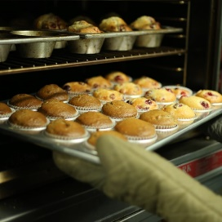
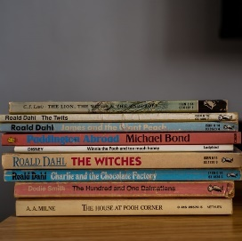




8
Find your journey through life, learning & work
You may not know what you want to do with your life and career at the moment, you may have some ideas, or you may be confident of what your path will look like. Either way, it is always useful to find out more!
Define: Career
The jobs that you do during your working life.
Final reflection activity (1-2 mins)
Think about the things you enjoy and the things you feel confident doing. Could any of these things help you find a career?
Challenge:
The National Careers Service provides careers information, advice and guidance. They can help you to make decisions on learning, training and work at all stages in your career. Why not check one of these out after the lesson?
©VotesforSchools The WOW Show 2022
Notes:
Images
Unsplash
References
https://dictionary.cambridge.org/dictionary/english/career
https://nationalcareers.service.gov.uk/

Slide 26
Thank you!
©VotesforSchools The WOW Show 2022

