Slide 1

Our Region, Your Future
The world of work in the North East
Y10 Lesson
In association with VotesforSchools and The WOW Show
©VotesforSchools The WOW Show 2022

Slide 2






Learning objectives for today
Recognising the value of challenging yourself and trying new things.
Researching how recruitment and selection processes work and what you need to do to succeed in them.
Taking steps to achieve in your GSCEs and make a decision about your post-16 pathway.
Being able to reflect on and change your career ideas and the strategies that you are pursuing to achieve them.
Identifying what you can do, individually and with others, to challenge prejudice, stereotyping and discrimination in learning and workplaces.
Exploring local and national labour market trends.
©VotesforSchools The WOW Show 2022
Notes:
References
https://www.thecdi.net/New-Career-Development-Framework

Slide 3
Keywords
Keywords
Labour Market Information (LMI): Information about the jobs and careers available in a geographical area.
Sector: The areas into which the economic activity of a country is divided.
Employability: Having the skills and abilities needed to have a job or career.
Career: The job or series of jobs that you do during your working life.
Prejudice: An unfair and unreasonable opinion or feeling, especially when formed without enough thought or knowledge.
Stereotype: A set idea that people have about what someone or something is like, especially an idea that is wrong.
Discrimination: Treating a person or particular group of people differently, especially in a worse way from the way in which you treat other people, because of their skin colour, sex, sexuality, etc.
©VotesforSchools The WOW Show 2022
Notes:
References
https://dictionary.cambridge.org/dictionary/english/sector
https://dictionary.cambridge.org/dictionary/english/employability
https://dictionary.cambridge.org/dictionary/english/career
https://dictionary.cambridge.org/dictionary/english/labour-market

Slide 4

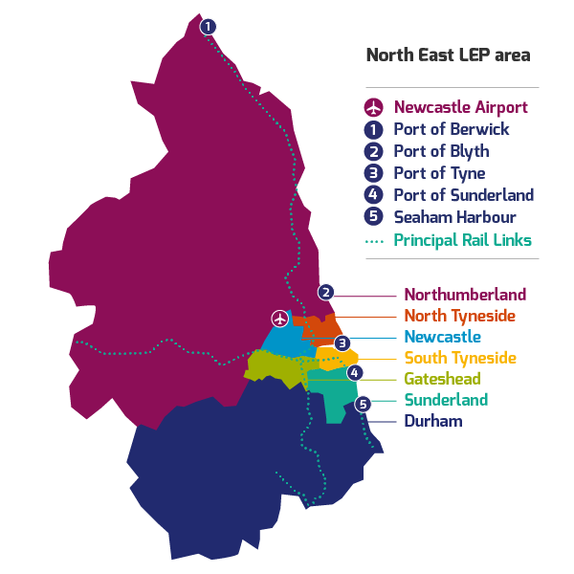
1
What is Labour Market Information?
Define: Labour Market Information(LMI)
This tells you about the current work and job opportunities in your area.
LMI is important for social mobility. It allows young people to be more equipped to understand what is on offer in their region and how to get there by making informed decisions about their future career choices.
Class discussion (2-3 mins)
How do you think Labour Market Information could help you find a job in your area?
It helps decode the world of work by breaking it down into digestible chunks.
LMI highlights the fantastic career opportunities available and what existing opportunities and growth areas there are in your region.
©VotesforSchools The WOW Show 2022
Notes:
References:
http://www.lmiforall.org.uk/explore_lmi/
https://www.lmiforall.org.uk/explore_lmi/learning-units/what-is-lmi/ - There is a YouTube video explaining LMI if needed on this page.

Slide 5


1
What is Labour Market Information?
LMI can help you understand what types of career are available near you. It can also show how many jobs there are in different sectors now, and how many there are projected to be in the future.
Define: Sector
An area of work and production that makes money for an area or country.
Individual activity (2-3 mins)
Write down three careers that interest you for the future.
LMI could help you see where job opportunities are and how much certain roles pay. This can help you think about what you want to do.
LMI is updated regularly, so you can see how job opportunities change and some sectors grow.
©VotesforSchools The WOW Show 2022
Notes:
References
http://www.lmiforall.org.uk/explore_lmi/
https://www.lmiforall.org.uk/explore_lmi/learning-units/what-is-lmi/ - There is a YouTube video explaining LMI if needed on this page.
Images:
1) NELEP

Slide 6







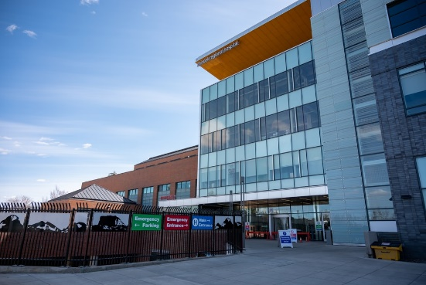
2
The North East Labour Market
Pair discussion (2-3 mins)
Talk to your partner about what opportunities you know of in your local area – click for some picture hints. Then, head to the next slide for more information on the sectors that have roles on offer in the North East.
Challenge:
Do you know what kind of work is involved in each of these sectors?
©VotesforSchools The WOW Show 2022
Notes:
Please Note: The North East Local Enterprise Partnership works with partners to develop a more competitive economy for the North East, Helping to create more and better jobs for everyone.
Images
Unsplash
References
https://www.northeastambition.co.uk/toolkits/labour-market-insights-toolkit
https://www.northeastlep.co.uk/key-sectors/
https://evidencehub.northeastlep.co.uk/report/gva-industry
https://dictionary.cambridge.org/dictionary/english/manufacturing
https://dictionary.cambridge.org/dictionary/english/administration
https://dictionary.cambridge.org/dictionary/english/retail
https://dictionary.cambridge.org/dictionary/english/social-care

Slide 7




2
The North East Labour Market
Transport & Logistics:
Movement of people and goods (things we buy).
Advanced Manufacturing:
This includes making parts for cars, trains, electronics and subsea engineering.
Construction:
Building and work across all parts of our built environment.
Health & Life Sciences:
Research and development into health and care (looking after people).
©VotesforSchools The WOW Show 2022
Notes:
Please Note: The North East Local Enterprise Partnership works with partners to develop a more competitive economy for the North East, Helping to create more and better jobs for everyone.
Images
Unsplash
References
https://www.northeastambition.co.uk/toolkits/labour-market-insights-toolkit
https://www.northeastlep.co.uk/key-sectors/
https://evidencehub.northeastlep.co.uk/report/gva-industry
https://dictionary.cambridge.org/dictionary/english/manufacturing
https://dictionary.cambridge.org/dictionary/english/administration
https://dictionary.cambridge.org/dictionary/english/retail
https://dictionary.cambridge.org/dictionary/english/social-care

Slide 8




2
The North East Labour Market
Digital:
Work involving Information Technology (IT) and digital data.
Education:
There are over 1,150 schools in the North East and five universities.
Financial & Business Services:
This includes financial and legal services.
Energy:
Research and development in producing energy.
©VotesforSchools The WOW Show 2022
Notes:
Please Note: The North East Local Enterprise Partnership works with partners to develop a more competitive economy for the North East, Helping to create more and better jobs for everyone.
There are four Universities in the North East LEP and one in Tees Valley
There are nine Further Education colleges and two sixth forms
There are over 240 secondaries including SEND, PRU and Alternative Provision
There are over seven hundred primaries
Images
Unsplash
References
https://www.northeastambition.co.uk/toolkits/labour-market-insights-toolkit
https://www.northeastlep.co.uk/key-sectors/
https://evidencehub.northeastlep.co.uk/report/gva-industry
https://dictionary.cambridge.org/dictionary/english/manufacturing
https://dictionary.cambridge.org/dictionary/english/administration
https://dictionary.cambridge.org/dictionary/english/retail
https://dictionary.cambridge.org/dictionary/english/social-care

Slide 9


3
Your North East opportunities in Transport & Logistics
The North East has a whole host of careers in transport. There are buses, trains, a ferry and aircraft at Newcastle Airport.
0:00-2:22
A wide variety of roles exist across these modes of transport. These include things like driving, maintenance, planning routes, design, or administration.
Class activity (4 mins)
Click the image to watch the video and discuss any of the careers featured that you would be interested in.
Good transport networks helps people move for jobs and leisure and distribute goods and services across the economy.
Challenge:
What do you think is important to think about when you are planning transport systems?
©VotesforSchools The WOW Show 2022
Notes:
YouTube Video Link: https://www.youtube.com/watch?v=pVUSJl6nCJk&t=12s
SafeShare Video Link: https://safeshare.tv/x/pVUSJl6nCJk
Image
Via video
References
https://evidencehub.northeastlep.co.uk/our-data/transport/
https://www.northeastlep.co.uk/the-plan/support/transport-and-logistics/

Slide 10








4
Do you challenge yourself?
Pair activity (4-5 mins)
Talk to a partner: Have you started to look at the jobs market? Do you know what you want to do and what you need to do to get there? Consider the questions below as part of your discussion.
What are you doing to achieve good grades?
Are you doing extra activities to make your application stand out?
Have you done any research into the careers you are interested in?
Have you looked at hours and pay of the jobs you are interested in?
Have you started to build a CV of your qualifications?
Have you researched any interview techniques?
©VotesforSchools The WOW Show 2022
Notes:
References:
https://www.themix.org.uk/work-and-study
https://icould.com/
Images
Unsplash

Slide 11

5
What are stereotypes?
There’s a chance you may have an image in mind of the kind of people who are likely to work in a particular sector, which might have made you think that perhaps a career in that sector is not for you. Let’s explore that…
Class discussion (4-5 mins)
Click the image to watch a short film. When you’ve finished, discuss the following question: are there any roles that you think can only be carried out by just one “type” of person? Why?
0:00-4:46
We can sometimes assume that certain sectors and roles require a particular person. However, the opposite is true! Most careers are open to everyone when they receive the right training.
Individual reflection (1-2 mins)
What is it about certain roles that make us think that only one type of person can do them?
Do you think there are there any exceptions?
©VotesforSchools The WOW Show 2022
https://safeshare.tv/x/9xCn-Kwy97U
Notes:
YouTube Video Link: https://www.youtube.com/watch?v=R0wni0rOOQc
SafeShare Video Link: https://safeshare.tv/x/R0wni0rOOQc
Images
1) Via video

Slide 12

6
What is discrimination?
Stereotyping can lead to discrimination without realising it, so it is important to always treat people equally.
Definition: Stereotype:
A set idea that people have about what someone or something is like, especially an idea that is wrong.
Equality means making sure individuals or groups are not treated differently based on a specific “protected characteristic”. These characteristics include race, gender, disability, religion or belief, sex, sexual orientation and age.
Pair discussion (2-3 mins)
Talk to a partner about the following question: have you ever felt discriminated against? When? What did you do?
Diversity aims to recognise, respect and value people’s differences. This then means they are able to reach their full potential and contribute to society because they have been encouraged through an inclusive culture.
©VotesforSchools The WOW Show 2022
Notes:
Images
iStock
References
https://dictionary.cambridge.org/dictionary/english/discrimination
https://www.oxfordshirelep.com/sites/default/files/uploads/Equality%20and%20Diversity%20Statement%20v2%20230519.pdf

Slide 13


6
What is discrimination?
As you have seen today, discrimination can affect what we choose to do as a future career. This can then lead to industries or companies missing out on having a more diverse workforce (the group of people working for them).
Individual reflection (1-2 mins)
How has what you have explored so far today opened your eyes to your own career possibilities?
How will you use what you have learned today to make sure you find your future?
Challenge:
Spend some time talking to a friend or relative. Has discrimination and stereotyping changed over time? How?
©VotesforSchools The WOW Show 2022
Notes:
Images
Unsplash

Slide 14

7
Pathways to your future: What follows your GCSEs?
Before kickstarting your career, some transitions need to take place! This can be a move into sixth form, further education, a traineeship, apprenticeship or a job.
Define: Transition
The change from one part of your life to a new phase.
0:00-1:57
Pair discussion (3-5 mins)
Click the image to watch a video about choices after GCSEs. Discuss with your partner: what can you do to make sure you are making the best choice for your success?
During the two years in KS4, you may change ideas about your future, but there is time to find out more.
It is important to choose the right pathway to make sure you are qualified to do your dream job!
But, if you are not sure what you want to do, try to choose a good balance to keep your options open.
Don’t forget, most of us work for about 50 years, so it’s important you choose things that you enjoy!
©VotesforSchools The WOW Show 2022
Notes:
YouTube Video Link: https://www.youtube.com/watch?v=f_xAQNNi4pA
SafeShare Video Link: https://safeshare.tv/x/f_xAQNNi4pA
Images
Via video
References
https://www.prospects.ac.uk/careers-advice/getting-a-job/skills-shortages-and-covid-19
https://dictionary.cambridge.org/dictionary/english/transition

Slide 15


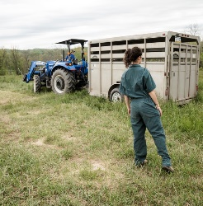




8
Pursuing your future
Post-16, there are a number of pathways into the job you want. The pathway you take will depend on the kind of job you want and the type of learner you are.
Pair/Small group discussion (2-3 mins)
Discuss with a partner or in a small group: what do you want to do when you leave school? Click if you need some inspiration!
Apprenticeships
Traineeships
T Levels
A Levels
Internships
University
Challenge:
Amazing Apprenticeships has a huge amount of help and support about every aspect of finding your future career and training needs. Why not check them out?
©VotesforSchools The WOW Show 2022
https://safeshare.tv/x/9xCn-Kwy97U
Notes:
Images
Unsplash
Amazing Apprenticeships
References
https://amazingapprenticeships.com/resource/tlevels-guide/
https://www.gov.uk/government/publications/t-levels-resources-for-teachers-and-careers-advisers
https://amazingapprenticeships.com/resources

Slide 16




8
Pursuing your future
Some jobs require specialist qualifications and skills. It’s good to be aware of this if you’re interested in a specific career so you can get on to the right study pathway as early as possible.
Pair discussion (2-3 mins)
Do you know where to look for extra information on the careers you are interested in? You could find out more at home too!
You could share useful websites, apps and YouTube channels that you think will help with job hunting, applications and being successful in interviews.
Challenge:
On the next slide you will find out more about how jobs are created, which could help you with an application. Think about and discuss how this information helps you with writing a successful application.
©VotesforSchools The WOW Show 2022
Notes:
Images
North East LEP

Slide 17





9
Recruitment & selection
Final individual activity (1-2 mins)
There are five simple steps to the recruitment and selection process. Click to see them in action!
1
Identify the vacancy:
A business may need more people or someone may leave.
Job analysis:
The business then decides what it needs from a new employee.
2
Create a job description:
This will contain information about pay, conditions, duties and hours.
3
4
Create a person specification:
What the business needs is matched to qualifications & skills.
5
Advertise the job:
The job advert is released so that people can apply.
©VotesforSchools The WOW Show 2022
Notes:
Images
Unsplash
References
https://www.bbc.co.uk/bitesize/guides/z3s9fcw/revision/2 - A good source of information on this area of the framework

Slide 18
Thank you!
©VotesforSchools The WOW Show 2022

