Slide 1

Our Region, Your Future
The world of work in the North East
Y11 Lesson
In association with VotesforSchools and The WOW Show
©VotesforSchools The WOW Show 2022

Slide 2






Learning objectives for today
Considering what learning pathway you should pursue next.
Recognising the main learning pathways and considering which one you want to follow and how you will access and succeed in it.
Making plans and developing a pathway into your future.
Being able to reflect on and change your career ideas and the strategies that you are pursuing to achieve them.
Reflecting on the different ways in which people balance their work and life.
Exploring local and national labour market trends.
©VotesforSchools The WOW Show 2022
Notes:
References
https://www.thecdi.net/New-Career-Development-Framework

Slide 3
Keywords
Labour Market Information (LMI): Information about the jobs and careers available in a geographical area.
Sector: The areas into which the economic activity of a country is divided.
Employability: Having the skills and abilities needed to have a job or career.
Career: The job or series of jobs that you do during your working life.
Labour market: The supply of people in a particular country or area who are able and willing to work.
Work-life balance: The amount of time you spend doing your job compared with the amount of time you spend with your family and doing things you enjoy.
©VotesforSchools The WOW Show 2022
Notes:
References
https://dictionary.cambridge.org/dictionary/english/sector
https://dictionary.cambridge.org/dictionary/english/employability
https://dictionary.cambridge.org/dictionary/english/career
https://dictionary.cambridge.org/dictionary/english/labour-market

Slide 4

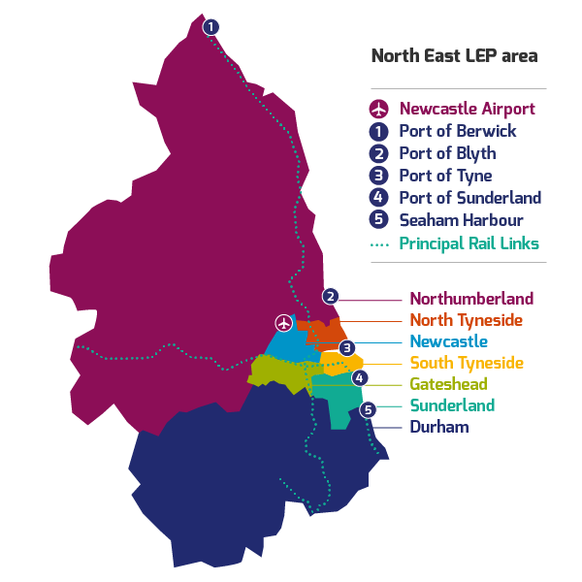
1
What is Labour Market Information?
Define: Labour Market Information (LMI)
This tells you about the current work and job opportunities in your area.
LMI is important for social mobility. It allows young people to be more equipped to understand what is on offer in their region and how to get there by making informed decisions about their future career choices.
Class discussion (2-3 mins)
How do you think Labour Market Information could help you find a job in your area?
It helps decode the world of work by breaking it down into digestible chunks.
LMI highlights the fantastic career opportunities available and what existing opportunities and growth areas there are in your region.
©VotesforSchools The WOW Show 2022
Notes:
Images
North East LEP
References
http://www.lmiforall.org.uk/explore_lmi/
https://www.lmiforall.org.uk/explore_lmi/learning-units/what-is-lmi/ - There is a YouTube video explaining LMI if needed on this page.

Slide 5


1
What is Labour Market Information?
LMI can help you understand what jobs are available near to you and how many jobs there are in different sectors now and projected in the future.
Define: Sector
An area of work and production that makes money for an area or country.
Individual activity (2-3 mins)
Write down three careers that interest you for the future.
LMI could help you see where job opportunities are and how much certain roles pay. This can help you think about what you want.
LMI is updated regularly, so you can see how job opportunities change and some sectors grow.
©VotesforSchools The WOW Show 2022
Notes:
Images
North East LEP
References
http://www.lmiforall.org.uk/explore_lmi/
https://www.lmiforall.org.uk/explore_lmi/learning-units/what-is-lmi/ - There is a YouTube video explaining LMI if needed on this page.

Slide 6
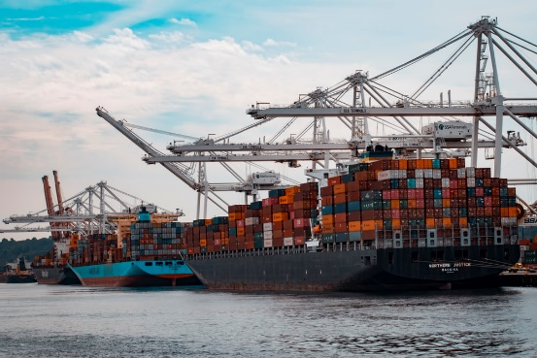






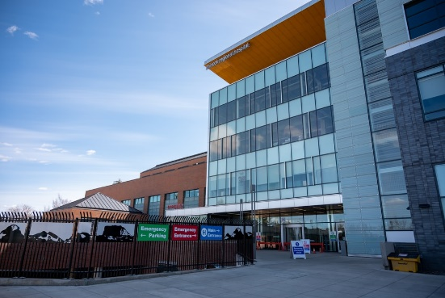
2
The North East Labour Market
Pair discussion (2-3 mins)
Talk to your partner about what opportunities you know of in your local area – click for some picture hints. Then, head to the next slide for more information on the sectors that have roles on offer in the North East.
Challenge:
Do you know what kind of work is involved in each of these sectors?
©VotesforSchools The WOW Show 2022
Notes:
Please Note: The North East Local Enterprise Partnership works with partners to develop a more competitive economy for the North East, Helping to create more and better jobs for everyone.
Images
Unsplash
References
https://www.northeastambition.co.uk/toolkits/labour-market-insights-toolkit
https://www.northeastlep.co.uk/key-sectors/
https://evidencehub.northeastlep.co.uk/report/gva-industry
https://dictionary.cambridge.org/dictionary/english/manufacturing
https://dictionary.cambridge.org/dictionary/english/administration
https://dictionary.cambridge.org/dictionary/english/retail
https://dictionary.cambridge.org/dictionary/english/social-care

Slide 7
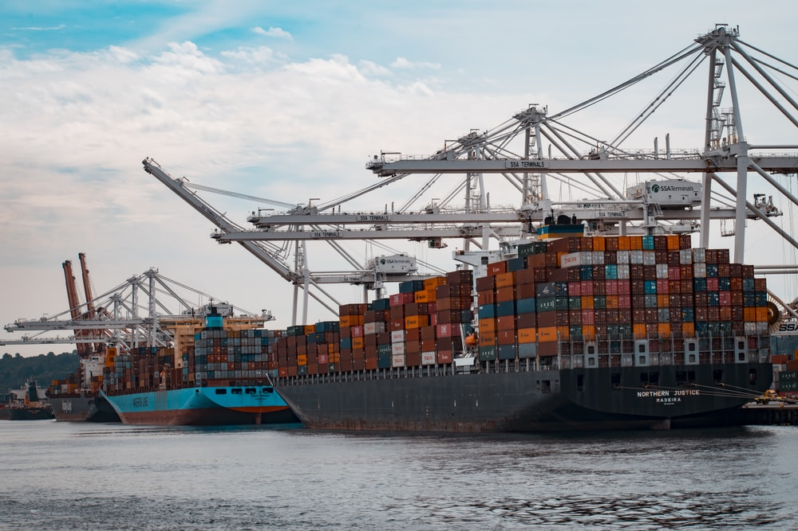



2
The North East Labour Market
Transport & Logistics:
Transport of people and movement of goods (things we buy).
Advanced Manufacturing:
This includes making parts for cars, trains, electronics and subsea engineering.
Construction:
Building and work across all parts of our built environment.
Health & Life Sciences:
Research and development into health and care (looking after people).
©VotesforSchools The WOW Show 2022
Notes:
Please Note: The North East Local Enterprise Partnership works with partners to develop a more competitive economy for the North East, Helping to create more and better jobs for everyone.
Images
Unsplash
References
https://www.northeastambition.co.uk/toolkits/labour-market-insights-toolkit
https://www.northeastlep.co.uk/key-sectors/
https://evidencehub.northeastlep.co.uk/report/gva-industry
https://dictionary.cambridge.org/dictionary/english/manufacturing
https://dictionary.cambridge.org/dictionary/english/administration
https://dictionary.cambridge.org/dictionary/english/retail
https://dictionary.cambridge.org/dictionary/english/social-care

Slide 8




2
The North East Labour Market
Digital:
Work involving Information Technology (IT) and digital data.
Education:
There are over 1,150 schools in the North East and five universities.
Financial & Business Services:
This includes financial and legal services.
Energy:
Research and development in producing energy.
©VotesforSchools The WOW Show 2022
Notes:
Please Note: The North East Local Enterprise Partnership works with partners to develop a more competitive economy for the North East, Helping to create more and better jobs for everyone.
There are four Universities in the North East LEP and one in Tees Valley
There are nine Further Education colleges and two sixth forms
There are over 240 secondaries including SEND, PRU and Alternative Provision
There are over seven hundred primaries
Images
Unsplash
References
https://www.northeastambition.co.uk/toolkits/labour-market-insights-toolkit
https://www.northeastlep.co.uk/key-sectors/
https://evidencehub.northeastlep.co.uk/report/gva-industry
https://dictionary.cambridge.org/dictionary/english/manufacturing
https://dictionary.cambridge.org/dictionary/english/administration
https://dictionary.cambridge.org/dictionary/english/retail
https://dictionary.cambridge.org/dictionary/english/social-care

Slide 9

3
Your North East opportunities in Construction
The North East has a vast array of interesting and rewarding opportunities within construction for everyone.
0:00-4:40
Over 6000 enterprises employ over 50,000 people in construction in the North East.
Class activity (4 mins)
Click the image to watch the video and listen to Charlotte's insight into her role at Bowmer & Kirkland and why she enjoys it so much. Think about what other careers there are in construction.
We will think more about work/life balance later!
The challenge of a more sustainable industry using new types of resources, reducing energy use and promoting recycling of materials
Challenge:
How do you think construction could address global climate change and support sustainable development?
©VotesforSchools The WOW Show 2022
Notes:
YouTube Video Link: https://www.youtube.com/watch?v=lZiRs-Wbo04&t=215s
SafeShare Video Link: https://safeshare.tv/x/ss61f9966e21f22
References:
https://www.neupc.ac.uk/buildingbetterfutures
https://www.northeastlep.co.uk/the-plan/support/construction/
https://www.mckinsey.com/business-functions/sustainability/our-insights/sustainability-blog Green construction information
https://www.netzeroteesside.co.uk/

Slide 10
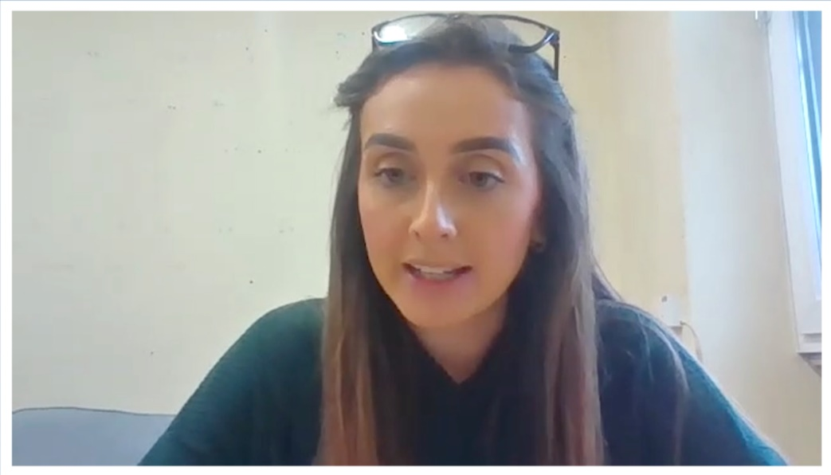
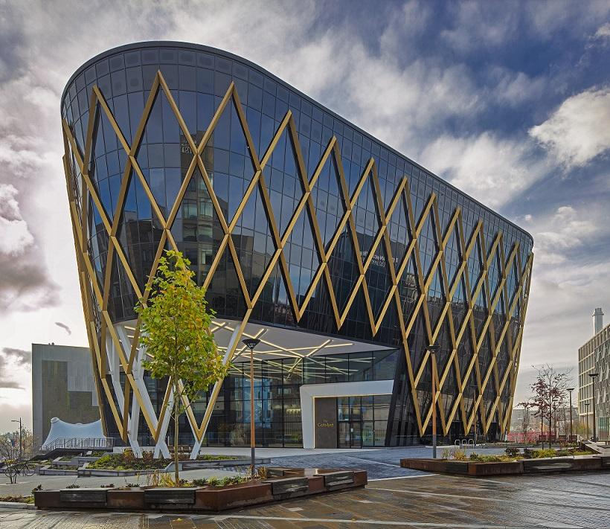


3
Your North East opportunities in Construction
Class activity (4 mins)
Click the image to watch the video of Hollie Statham from Bowmer + Kirkland. Are there any buildings you see locally that inspire you to be involved in construction?
0:00-2:32
As well as physical tasks of construction, there are designers, engineers, architects and all of the financial roles involved in a construction project.
©VotesforSchools The WOW Show 2022
Notes:
YouTube Video Link:
SafeShare Video Link: https://safeshare.tv/x/ss6217ee56c47db
References:
https://www.bandk.co.uk/
Images:
1) https://www.newcastle.gov.uk/citylife-news/digital/north-tyne-ps10m-digital-boost

Slide 11


4
Reflecting on your career ideas
Pair activity (4-5 mins)
Talk to a partner about what you want your future to look like. Be really aspirational, and think about as many aspects of your future as you can! Go through the next few slides to see some ideas and questions to help you.
©VotesforSchools The WOW Show 2022
Notes:
Images
Unsplash

Slide 12

4
Reflecting on your career ideas
What are you good at?
What are your interests?
What?
What makes you happiest?
©VotesforSchools The WOW Show 2022
Notes:
Images
Unsplash

Slide 13

4
Reflecting on your career ideas
Where do you want to live?
Where do you see yourself in 10 years?
Where?
Where do you want to study?
©VotesforSchools The WOW Show 2022
Notes:
Images
Unsplash

Slide 14

4
Reflecting on your career ideas
How much would you like to earn?
How much would you like to work?
How?
How would you like to work (e.g. remotely)?
©VotesforSchools The WOW Show 2022
Notes:
Images
Unsplash

Slide 15

4
Reflecting on your career ideas
Individual reflection (1-2 mins)
Are you excited by your future? It is in your hands!
©VotesforSchools The WOW Show 2022
Notes:
Images
Unsplash

Slide 16








5
Making plans for your future: Interviews
Interviews are a vital first step towards attaining the future you want, no matter what your chosen sector or career. So, how much do you know about the do’s and don’ts?
Pair discussion (3-5 mins)
Spend 2 minutes discussing with a partner what your Top 3 Tips for interview success would be, based on your experience and knowledge. Then, head to the next slide to see if any of your suggestions are listed.
©VotesforSchools The WOW Show 2022
Notes:
References:
https://www.themix.org.uk/work-and-study
https://icould.com/
Images
Unsplash

Slide 17



5
Making plans for your future: Interviews
Be prepared:
Knowing your stuff so you’re ready for anything is vital for a successful interview.
Look after yourself:
Before your interview, try to keep hydrated, eat well and stay calm.
First impressions count:
Make yours a good one by dressing smartly.
Concentrate:
Talk slowly and clearly, and don’t hesitate to stop to think about your answers.
Listen carefully:
Get them to clarify or repeat if you don't understand the question.
Be honest:
Answer questions truthfully and don’t be afraid to ask questions of your own.
Challenge:
Choose one of these pieces of advice. What could you do to work on this for yourself?
©VotesforSchools The WOW Show 2022
https://saeshare.tv/x/9xCn-Kwy97U
Notes:
Images
Unsplash

Slide 18


5
Making plans for your future: Pathways
Heading off to university or into your first job aren’t the only options! Vocational study focuses on work-related subjects and can even include some work experience. They suit those who want a more practical focus or have a good idea of the job they want.
Define: T Levels
A two-year qualification as an alternative to A levels, apprenticeships or other post-16 courses.
Pair activity (2-3 mins)
Talk to a different partner about your future plans. Are you thinking about further education, or would you prefer a practical way to gain the skills you need? What opportunities are there in the North East?
T Levels are an option you may not have considered when it comes to planning your future. They combine classroom learning with industry experience that is specifically designed for a certain sector or employer.
Challenge:
Click the logo to see links to T Levels in the North East.
©VotesforSchools The WOW Show 2022
https://saeshare.tv/x/9xCn-Kwy97U
Notes:
Images
1) Via video
References
https://www.tlevels.gov.uk/students
https://www.dynamonortheast.co.uk/the-north-easts-t-level-providers/
https://www.gov.uk/government/publications/introduction-of-t-levels/introduction-of-t-levels
https://www.gov.uk/government/publications/providers-selected-to-deliver-t-levels - List of T level providers.

Slide 19



6
Can you balance life & work?
Pair discussion (4-5 mins)
Although the practicalities of working life are important, another important aspect of your career will be balancing your time at work with other parts of your life. Talk to your partner about why balance is important for your physical and mental health and what we can do to strike this balance. Feeling stuck? Click for some ideas.
There is a lot of research that says spending time in nature is good for our mental health.
If you can’t spend time in nature, can you spend time with friends and family?
Could you spend time being creative with words, art, photography or another medium?
Individual reflection (1-2 mins)
How is your mental health? Do you know where to get help and support?
©VotesforSchools The WOW Show 2022
Notes:
Images
Unsplash
References
https://www.mind.org.uk/

Slide 20




Making plans for your future: More information
The internet has a whole host of information sources. For instance, The National Careers Service, Start and icould all have great support and advice. Click on the logos to visit their sites.
The National Careers Service provides careers information, advice and guidance. They can help you to make decisions on learning, training and work at all stages in your career.
Start will help you to find out which subjects and qualifications will help to prepare you for your future? Also, which pathway is right for you?
icould is a great place to get tips on GCSE options, apprenticeships, university, finding work (and much more!).
©VotesforSchools The WOW Show 2022
Notes:
Images & References
https://icould.com/
https://careers.startprofile.com/page/home-page
https://nationalcareers.service.gov.uk/

Slide 21
Thank you!
©VotesforSchools The WOW Show 2022

